Slide 1
Chapter 5
Advanced Data Modeling

Slide 2
Learning Objectives
After completing this chapter, you will be able to:
Describe the main extended entity relationship (EER) model constructs and how they are represented in ERDs and EERDs
Use entity clusters to represent multiple entities and relationships in an entity relationship diagram (ERD)
Describe the characteristics of good primary keys and how to select them
Apply flexible solutions for special data-modeling cases

Slide 3
The Extended Entity Relationship Model (EERM)
Enhanced entity relationship model
Result of adding more semantic constructs to the original entity relationship (ER) model
EER diagrams (EERDs) use the EER model

Slide 4
Entity Supertypes and Subtypes
Entity supertype
Generic entity type related to one or more entity subtypes
Contains common characteristics
Entity subtype
Contains unique characteristics of each entity subtype
Criteria to determine usage
There must be different, identifiable kinds of the entity in the user’s environment
The different kinds of instances should each have one or more attributes that are unique to that kind of instance

Slide 5
Specialization Hierarchy (1 of 2)
Entity supertypes and subtypes are organized in a specialization hierarchy
Depicts arrangement of higher-level entity supertypes and lower-level entity subtypes
Relationships are described in terms of “is-a” relationships
Subtype exists within the context of a supertype
Every subtype has one supertype to which it is directly related
Supertype can have many subtypes
A specialization hierarchy provides the means to:
Support attribute inheritance
Define a special supertype attribute known as the subtype discriminator
Define disjoint or overlapping constraints and complete or partial constraints

Slide 6
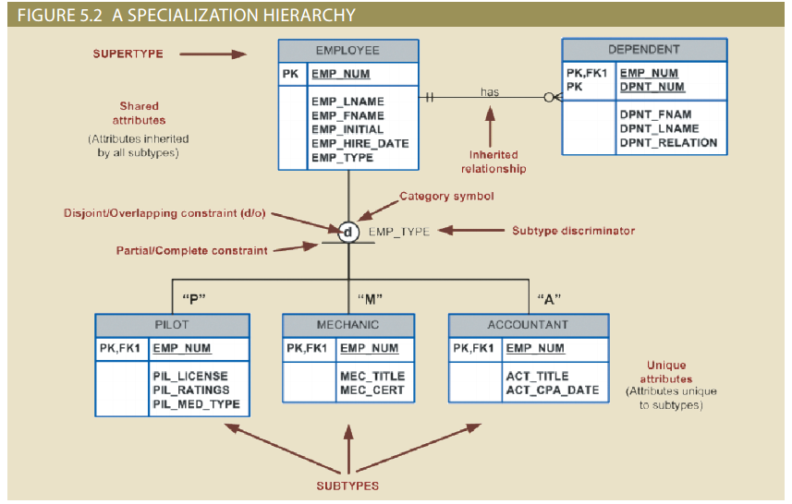
Specialization Hierarchy (2 of 2)

Slide 7
Inheritance (1 of 2)
Enables an entity subtype to inherit attributes and relationships of the supertype
All entity subtypes inherit their primary key attribute from their supertype
At the implementation level, supertype and its subtype(s) maintain a 1:1 relationship
Entity subtypes inherit all relationships in which supertype entity participates
Lower-level subtypes inherit all attributes and relationships from its upper-level supertypes

Slide 8
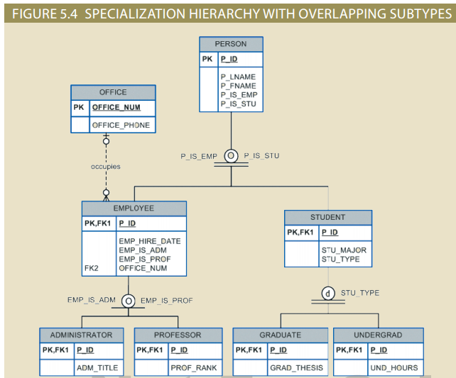
Inheritance (2 of 2)

Slide 9
Subtype Discriminator
Attribute in the supertype entity that determines to which entity subtype the supertype occurrence is related
Default comparison condition is the equality comparison
In some situations the subtype discriminator is not necessarily based on an equality comparison

Slide 10
Disjoint and Overlapping Constraints (1 of 2)
Disjoint subtypes: contain a unique subset of the supertype entity set
Known as nonoverlapping subtypes
Implementation is based on the value of the subtype discriminator attribute in the supertype
Overlapping subtypes: contain nonunique subsets of the supertype entity set
Implementation requires the use of one discriminator attribute for each subtype

Slide 11
Disjoint and Overlapping Constraints (2 of 2)
TABLE 5.1: Discriminator Attributes with Overlapping Subtypes
Discriminator Attributes: Professor | Discriminator Attributes: Administrator | Comment
Y | N | The Employee is a member of the Professor subtype.
N | Y | The Employee is a member of the Administrator subtype.
Y | Y | The Employee is both a Professor and an Administrator.

Slide 12
Completeness Constraint (1 of 2)
Specifies whether each supertype occurrence must also be a member of at least one subtype
Partial completeness: not every supertype occurrence is a member of a subtype
Total completeness: every supertype occurrence must be a member of at least one subtypes

Slide 13
Completeness Constraint (2 of 2)
Table 5.2 | Specialization Hierarchy Constraint Scenarios
Type | Disjoint Constraint | Overlapping Constraint
Partial | Supertype has optional subtypes. Subtype discriminator can be null. Subtype sets are unique. | Supertype has optional subtypes. Subtype discriminators can be null. Subtype sets are not unique.
Total | Every supertype occurrence is a member of only one subtype. Subtype discriminator cannot be null. Subtype sets are unique. | Every supertype occurrence is a member of at least one subtype. Subtype discriminators cannot be null. Subtype sets are not unique.

Slide 14
Specialization and Generalization
Specialization
Top-down process
Identifies lower-level, more specific entity subtypes from a higher-level entity supertype
Based on grouping unique characteristics and relationships of the subtypes
Generalization
Bottom-up process
Identifies a higher-level, more generic entity supertype from lower-level entity subtypes
Based on grouping common characteristics and relationships of the subtypes

Slide 15
Entity Clustering (1 of 2)
“Virtual” entity type used to represent multiple entities and relationships in ERD
Formed by combining multiple interrelated entities into a single, abstract entity object
General rule: avoid the display of attributes to eliminate complications that result when the inheritance rules change

Slide 16
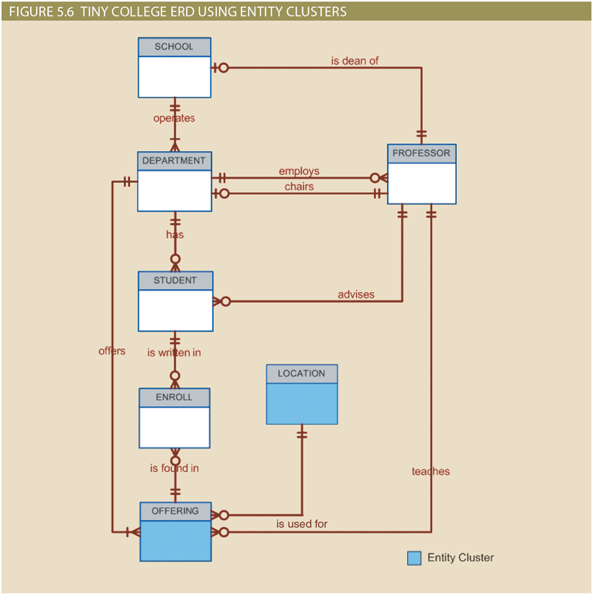
Entity Clustering (2 of 2)

Slide 17
Entity Integrity: Selecting Primary Keys
Primary keys: single attribute or a combination of attributes
Uniquely identifies each entity instance
Guarantees entity integrity
Works with foreign keys to implement relationships

Slide 18
Natural Keys and Primary Keys
Natural key or natural identifier: real-world identifier used to uniquely identify real-world objects
Familiar to end users and forms part of their day-to-day business vocabulary
Used as the primary key of the entity being modeled

Slide 19
Primary Key Guidelines
Desirable primary key characteristics
Non intelligent
No change over time
Preferably single-attribute
Preferably numeric
Security-compliant

Slide 20
When to Use Composite Primary Keys (1 of 2)
Identifiers of composite entities
Each primary key combination is allowed once in M:N relationship
Identifiers of weak entities
Strong identifying relationship with the parent entity
Represents a real-world object that is existence-dependent on another real-world object
Represented in the data model as two separate entities in a strong identifying relationship

Slide 21
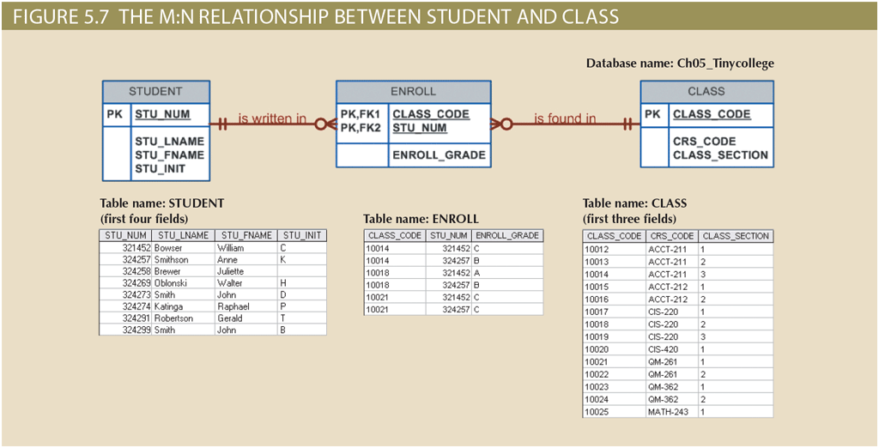
When to Use Composite Primary Keys (2 of 2)

Slide 22
When to Use Surrogate Primary Keys (1 of 2)
Primary key used to simplify the identification of entity instances
Useful when there is no natural key
Helpful if selected candidate key has embedded semantic contents or is too long
Require ensuring that the candidate key of entity in question performs properly
Use “unique index” and “not null” constraints

Slide 23
When to Use Surrogate Primary Keys (2 of 2)
Table 5.4: Data Used to Keep Track of Events
DATE | TIME_START | TIME_END | ROOM | EVENT_NAME | PARTY_OF
6/17/2018 | 11:00 a.m. | 2:00 p.m. | Allure | Burton Wedding | 60
6/17/2018 | 11:00 a.m. | 2:00 p.m. | Bonanza | Adams Office | 12
6/17/2018 | 3:00 p.m. | 5:30 p.m. | Allure | Smith Family | 15
6/17/2018 | 3:30 p.m. | 5:30 p.m. | Bonanza | Adams Office | 12
6/18/2018 | 1:00 p.m. | 3:00 p.m. | Bonanza | Boy Scouts | 33
6/18/2018 | 11:00 a.m. | 2:00 p.m. | Allure | March of Dimes | 25
6/18/2018 | 11:00 a.m. | 12:30 p.m. | Bonanza | Smith Family | 12

Slide 24
Design Case 1: Implementing 1:1 Relationships (1 of 3)
Foreign keys work with primary keys to properly implement relationships in relational model
Place primary key of the parent entity on the dependent entity as foreign key
Options for selecting and placing the foreign key
Place a foreign key in both entities
Place a foreign key in one of the entities

Slide 25
Design Case 1: Implementing 1:1 Relationships (2 of 3)
Table 5.5: Selection of Foreign Key in a 1:1 Relationship
Case | ER Relationship Constraints | Action
I | One side is mandatory and the other side | Place the PK of the entity on the mandatory side in the entity on the optional side as a FK, and make the FK mandatory
II | Both sides are optional | Select the FK that causes the fewest nulls, or place the FK in the entity in which the (relationship) role is played
III | Both sides are mandatory | See Case II, or consider revising your model to ensure that the two entities do not belong together in a single entity

Slide 26
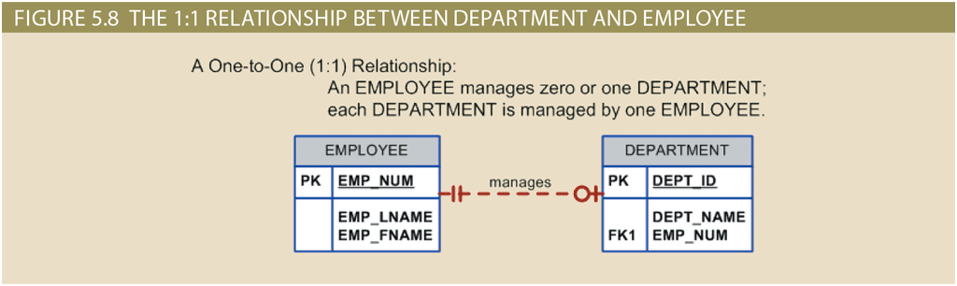
Design Case 1: Implementing 1:1 Relationships (3 of 3)

Slide 27
Design Case 2: Maintaining History of Time-Variant Data (1 of 4)
Time-variant data: data whose values change over time and for which a history of the data changes must be retained
Requires creating a new entity in a 1:M relationship with the original entity
New entity contains the new value, date of the change, and any other pertinent attribute

Slide 28
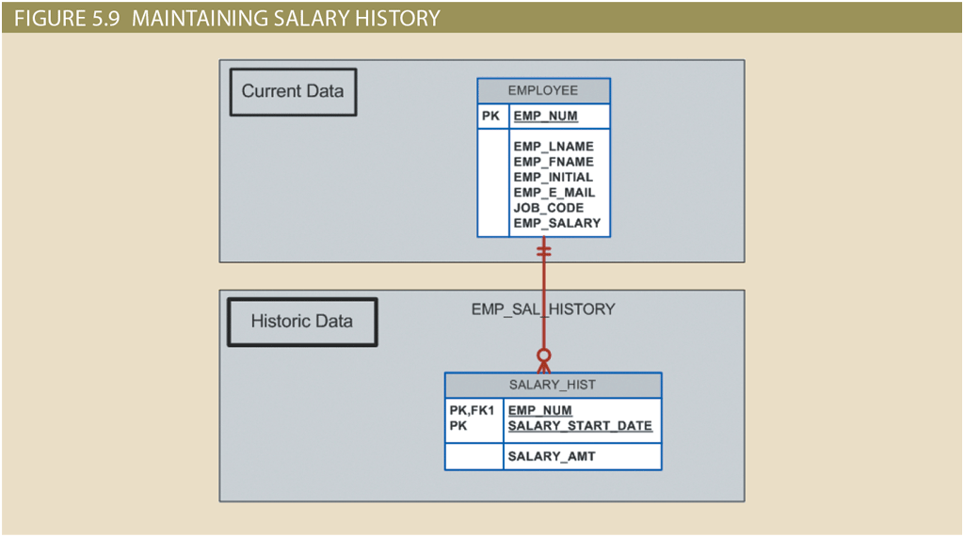
Design Case 2: Maintaining History of Time-Variant Data (2 of 4)

Slide 29
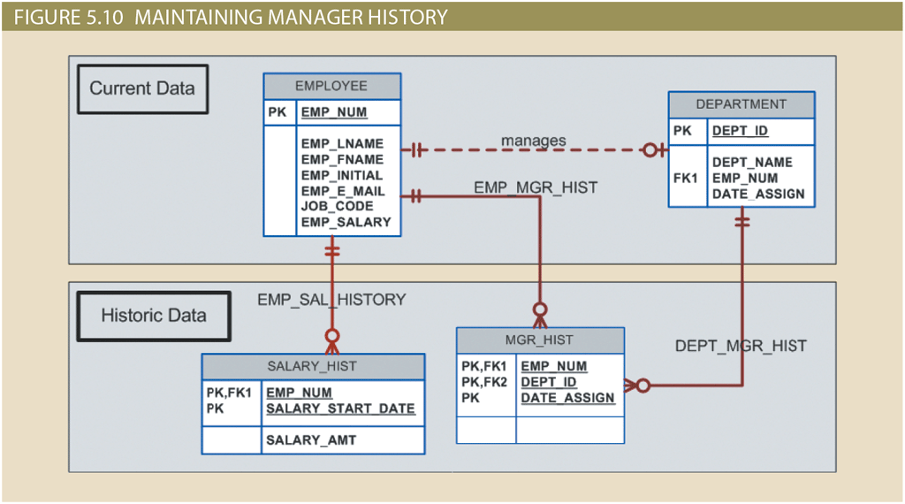
Design Case 2: Maintaining History of Time-Variant Data (3 of 4)

Slide 30
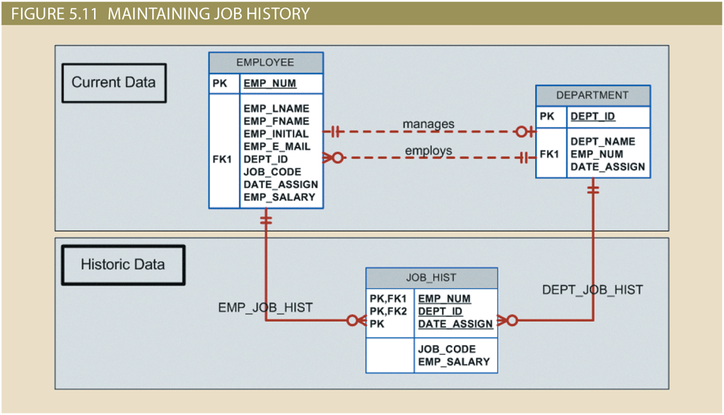
Design Case 2: Maintaining History of Time-Variant Data (4 of 4)

Slide 31
Design Case 3: Fan Traps (1 of 3)
Design trap: occurs when a relationship is improperly or incompletely identified
Represented in a way not consistent with the real world
Fan trap: occurs when one entity is in two 1:M relationships to other entities
Produces an association among other entities not expressed in the model

Slide 32
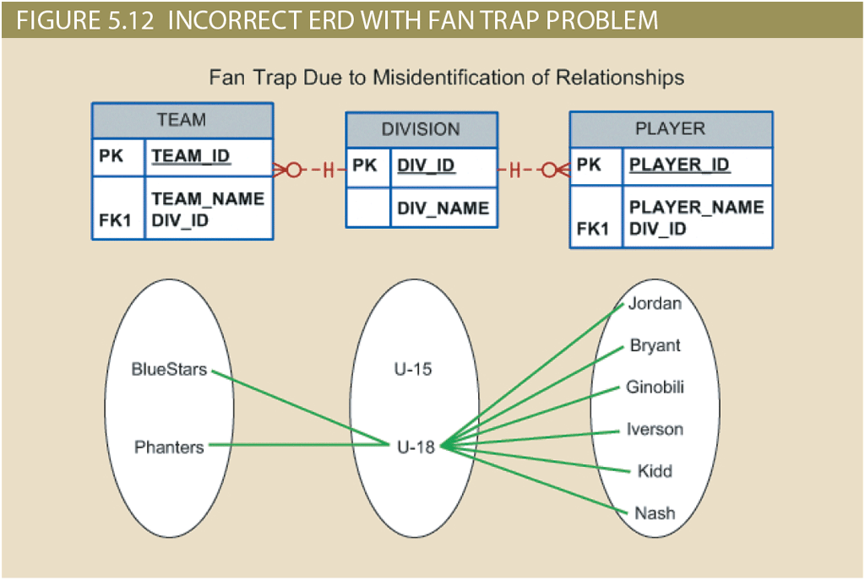
Design Case 3: Fan Traps (2 of 3)

Slide 33
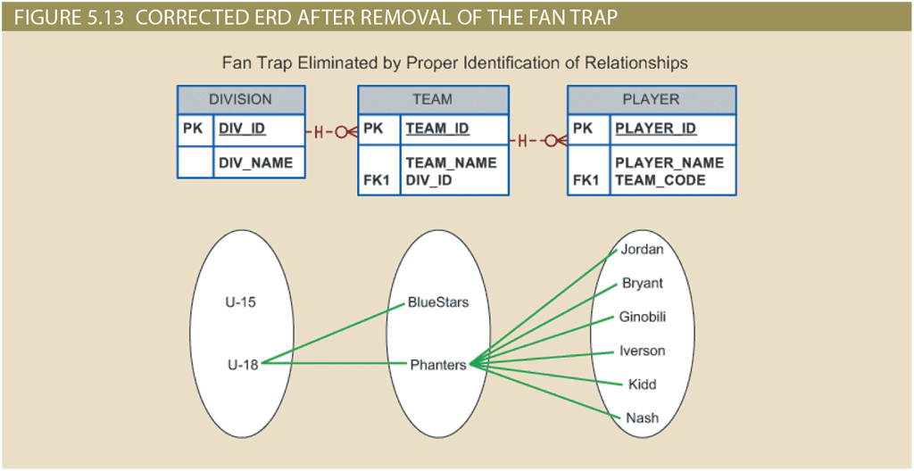
Design Case 3: Fan Traps (3 of 3)

Slide 34
Design Case 4: Redundant Relationships (1 of 2)
Occur when there are multiple relationship paths between related entities
Must remain consistent across the model
Help simplify the design

Slide 35
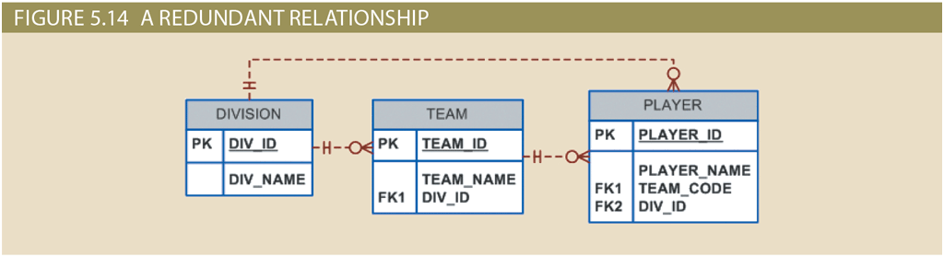
Design Case 4: Redundant Relationships (2 of 2)

Slide 36
Summary
The extended entity relationship (EER) model adds semantics to the ER model via entity supertypes, subtypes, and clusters
A specialization hierarchy depicts the arrangement and relationships between entity supertypes and entity subtypes
An entity cluster is a “virtual” entity type used to represent multiple entities and relationships in the ERD
Natural keys are identifiers that exist in the real world
Composite keys are useful to represent M:N relationships and weak (strong identifying) entities
Surrogate primary keys are useful when there is no natural key that makes a suitable primary key, when the primary key is a composite primary key with multiple data types, or when the primary key is too long to be usable
Time-variant data refers to data whose values change over time and require that you keep a history of data changes
A fan trap occurs when you have one entity in two 1:M relationships to other entities, and there is an association among the other entities not expressed in the model

